Slide 1
WelcomE to
our English class 5b
Đức Chính Primary School
Teacher:Trần Thị Bích
10/7/2016
Võ Thị Thoa

Slide 2
WARM UP

Slide 3
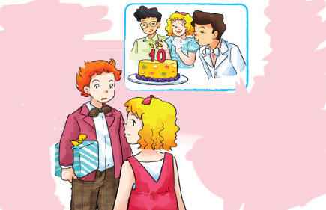
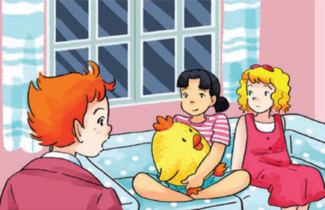
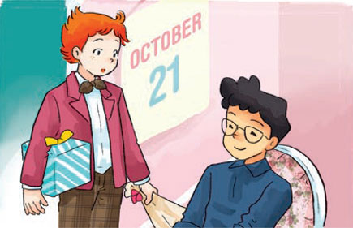
a
Are you going to Nam’s birthday party?
b
Nam’s
birthday party? It was last Sunday.
Did you
go to the
party?
Oh no! I thought it was today!
Yes, I did. I went with Phong
How about you, Mai? Did you go to the party?
c
d
Did you enjoy Nam’s party, Phong?
No, I didn’t. I visited
my grandparents.
Yes! We had a lot of fun

Slide 4
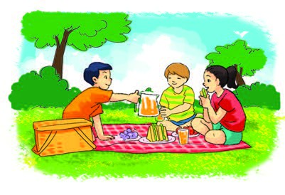
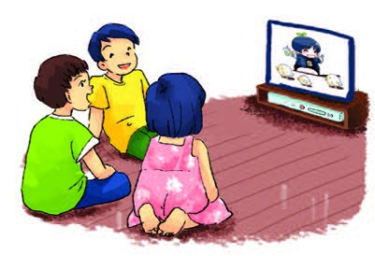
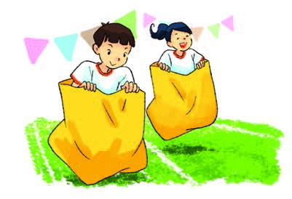
a
b
Enjoy the party
Go on a picnic
c
d
Join the funfair
Watch TV

Slide 5
gaMES

Slide 6
Thanks for your attention!

