Slide 1



WelcomE to
our English
Teacher:Trần Thị Bích
12/10/2016
Võ Thị Thoa

Slide 2
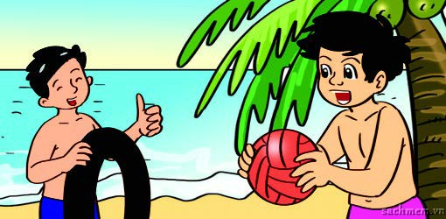

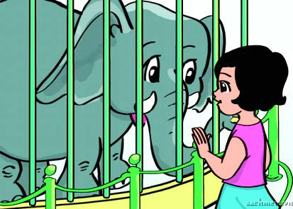
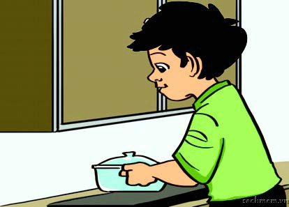
On the beach
In the school library
At the zoo
At home

Slide 3
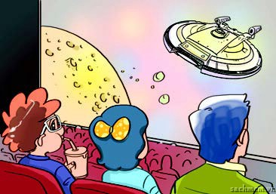
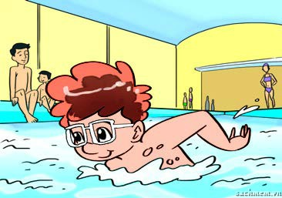
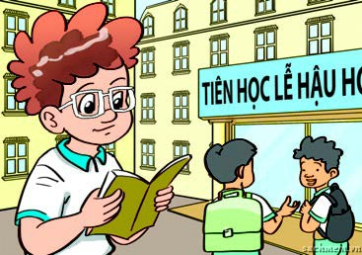


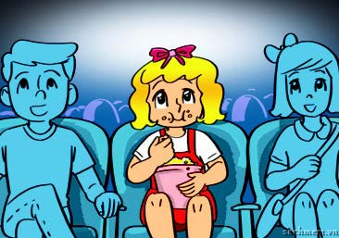
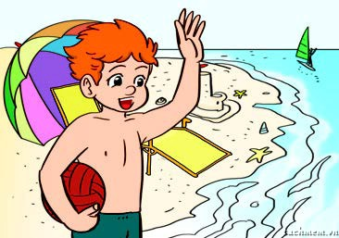

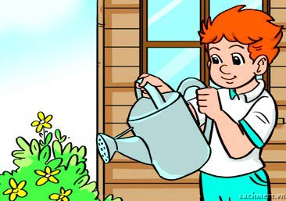
1.
a
b
c
√
2.
a
b
c
√
3.
a
b
c
√

Slide 4
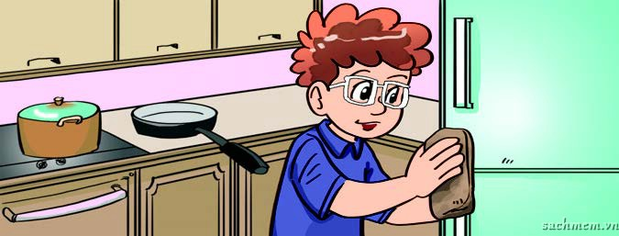

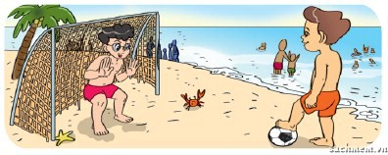
A: Where was Tom yesterday ?
B : He was ______________
at home
2.A:Where was Linda yesterday ? B:She was _____________
in the school library
3. A:Where was Phong and Nam yesterday ?
B: They were _______________
on the beach

Slide 5
Put the words in order
1. was /home/ at/ yesterday / I
I was at home yesterday
2. he/ at/ school/was
He was at school
3. in/the/ she/was/cinema
She was in the cinema
4. you/where/were/yesterday ?
Where were you yesterday ?

Slide 6
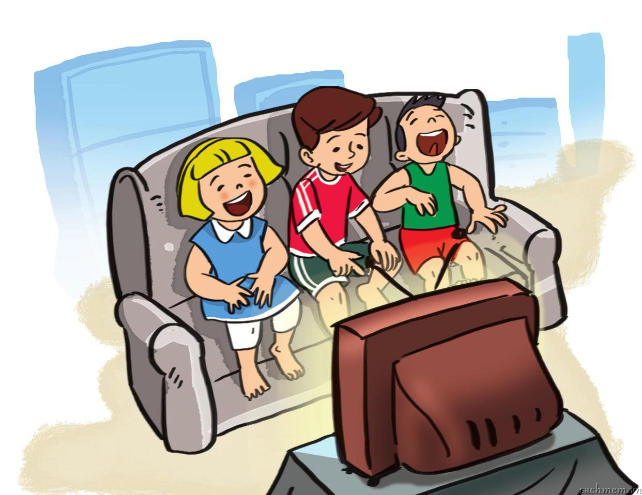
Where were you yesterday?
Where were you yesterday?
Yesterday, yesterday?
Where were you yesterday?
I was at home.
What did you do yesterday?
Yesterday, yesterday?
What did you do yesterday?
We watched TV.

Slide 7

Homework
- Learn by heartthe chant
- Do part 2,3 in your notebook.

Slide 8


Goodbye
See you later

