Slide 1
WelcomE to
our English class 5b
Đức Chính Primary School
Teacher:Trần Thị Bích
3/27/2017
Võ Thị Thoa

Slide 2
1.
a
b
c
2.
a
b
c
3.
a
b
c

Slide 3
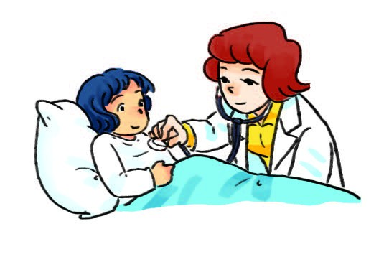
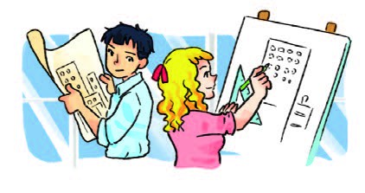
1.A: What would you like to be in the future, Hoa? B: I’d ………………………………………………………………….
2.A: What would Mary like to be when she grows up? B: She’d ………………………………………………………….
3.A: What would Linda and Trung like to do when they leave school? B: They’d ……………………………….

Slide 4
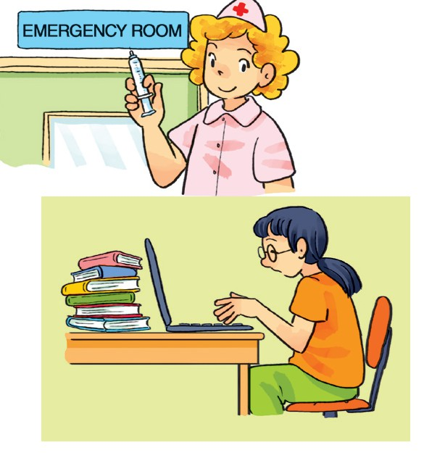
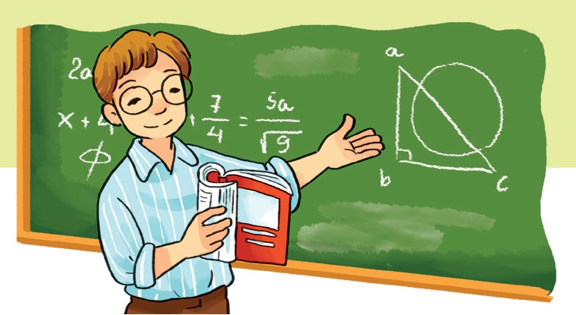
What would you like to be in the future?
What would you like to be?
What would you like to be?
What would you like to be
In the future?
I’d like to be a teacher.
What would you like to be?
What would you like to be?
What would you like to be in the future?
I’d like to be a nurse.
What would you like to be?
What would you like to be?
What would you like to be in the future?
I’d like to write stories for children.

Slide 5
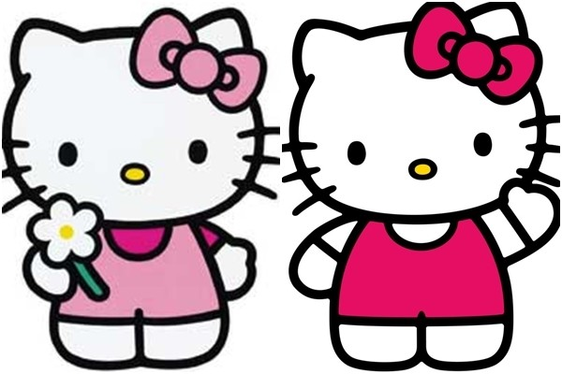
Thanks for your attention!

