Slide 1


Welcome to English class 3
Đức Chính Primary School
Teacher:Trần Thị Bích
2/13/2017
Võ Thị Thoa

Slide 2
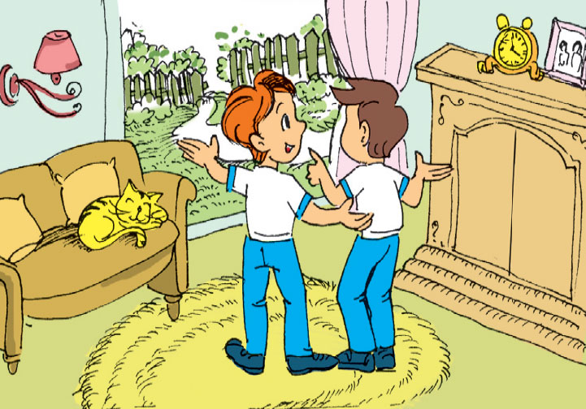
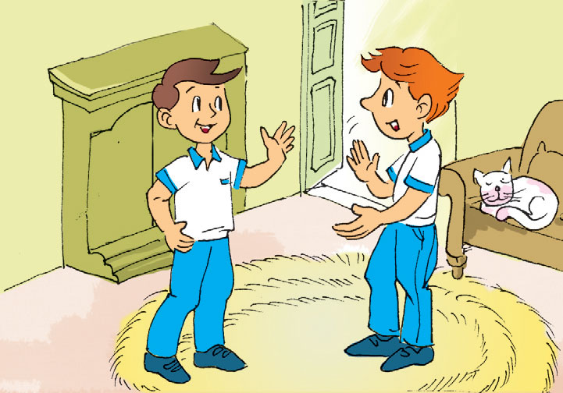
a
b
Is there a garden ?
This is the living room
Wow ! It’s nice !
Is there agarden
Yes, There is .
Come and see it
No, there isn’t

Slide 3
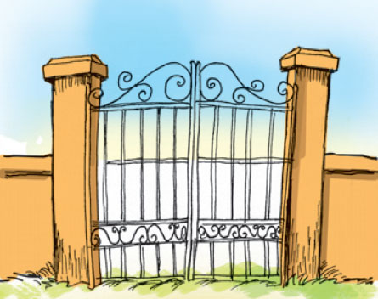
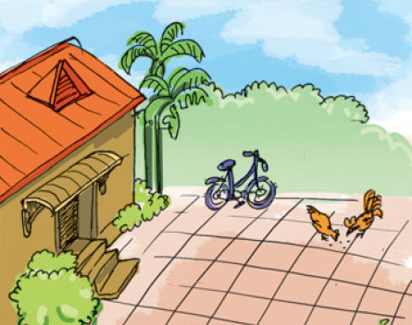
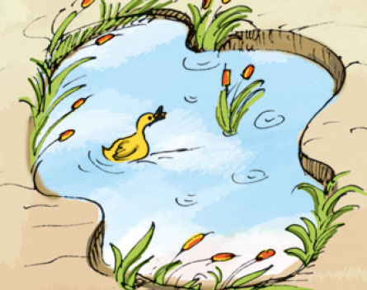
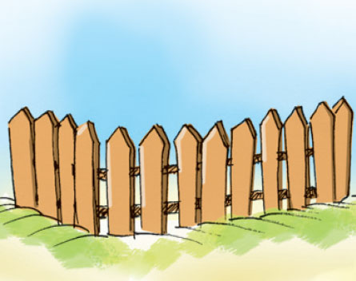

Slide 9


Thanks for your attention!

