Slide 1


Welcome to our class 4
Teacher:Trần Thị Bích

Slide 2


Slide 3
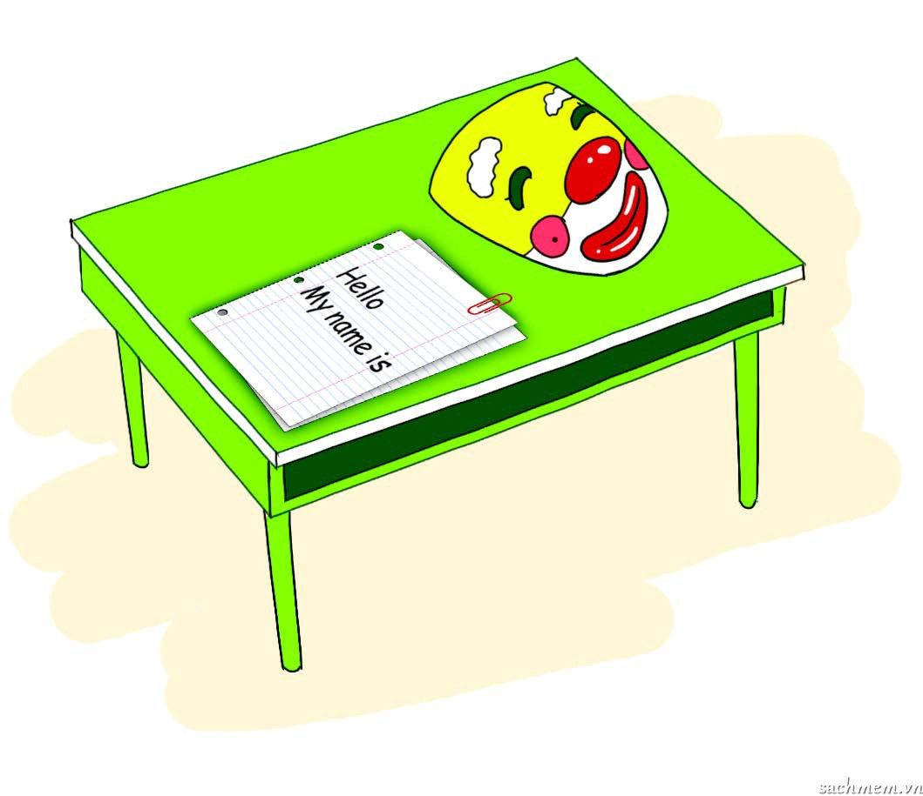
1.She's looking at the ______.
a. Mask b. text
2.The ______ is long.
a. Desk b. text
3.She's drawing a ______.
a. Desk b. mask
4.They're painting a ______.
a. Desk b. mask
mask
√
√√
desk
√
desk
√
mask
√

Slide 4
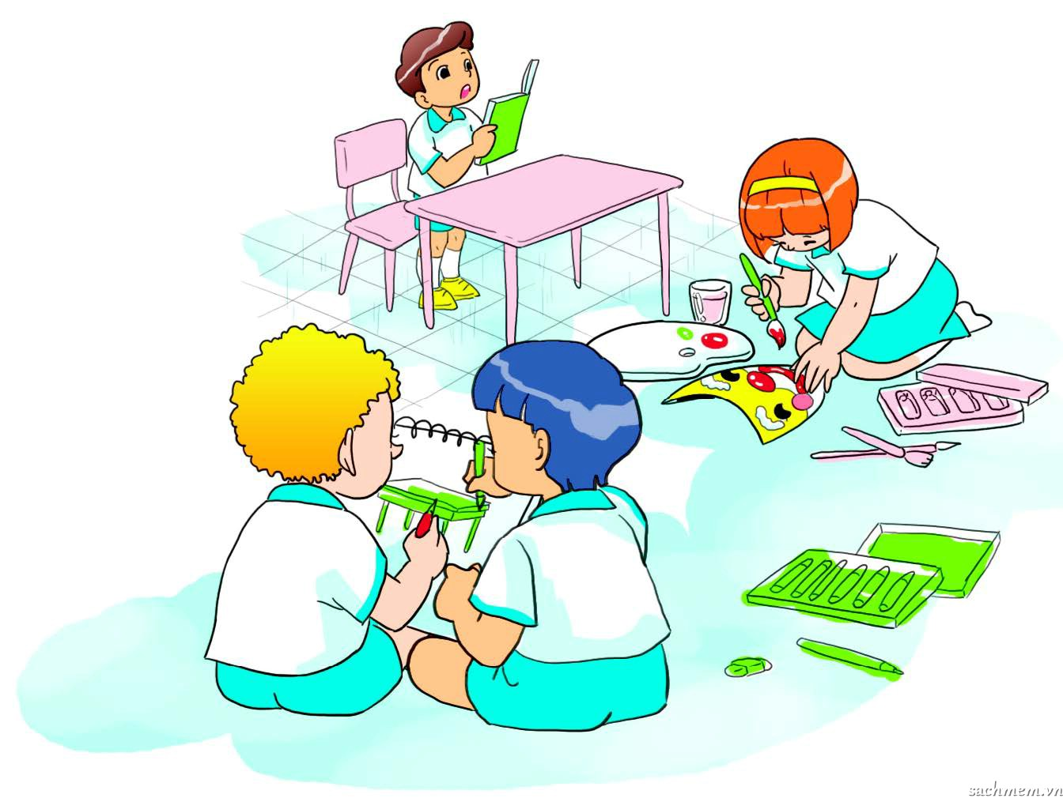
What's he doing?
What's he doing? He’s reading a text . What’s she doing? She’s painting a mask . What are they doing? They’re drawing a desk.

Slide 5

Homework
- Learn by heartthe chant
- Do part 2,3 in your notebook.

Slide 6


Goodbye
See you later

